Slide 1



Slide 2
WHY Streamlit
What is Streamlit - YouTube

Slide 3
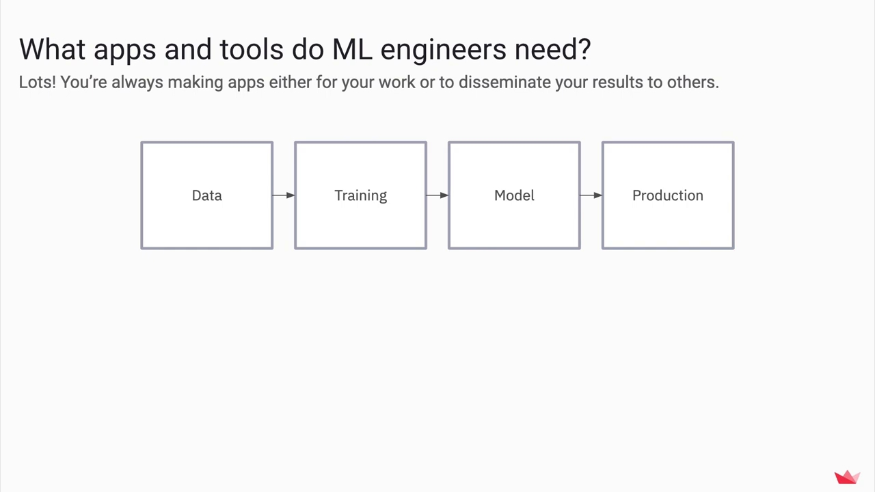

Slide 4
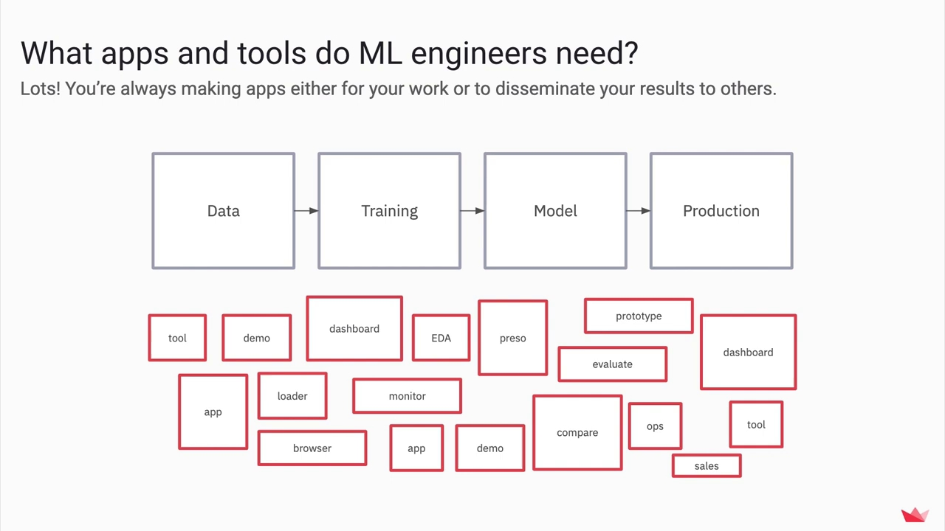

Slide 5
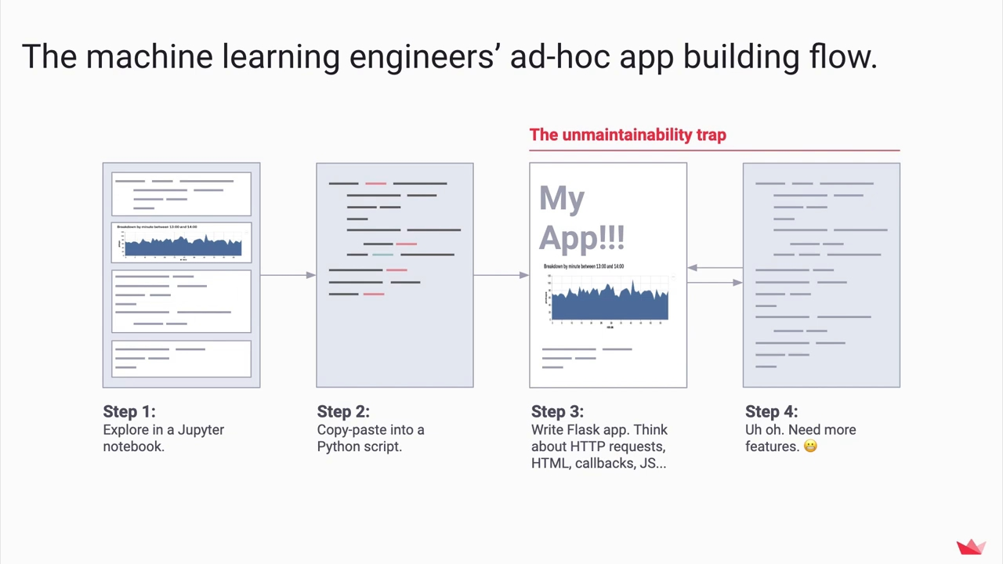

Slide 6
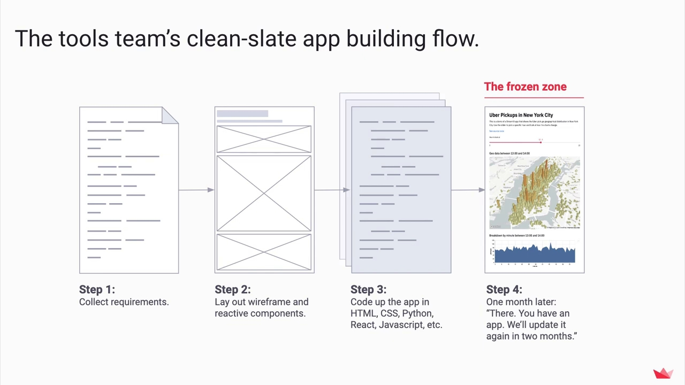

Slide 7
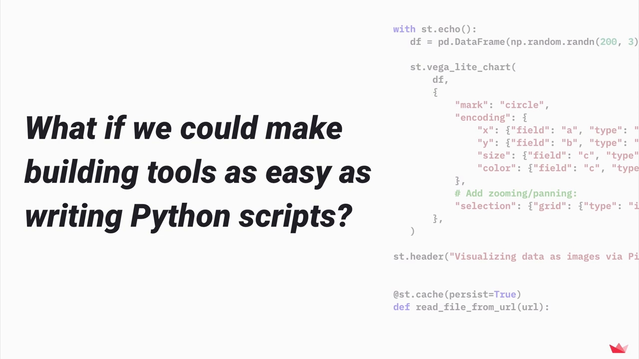

Slide 8
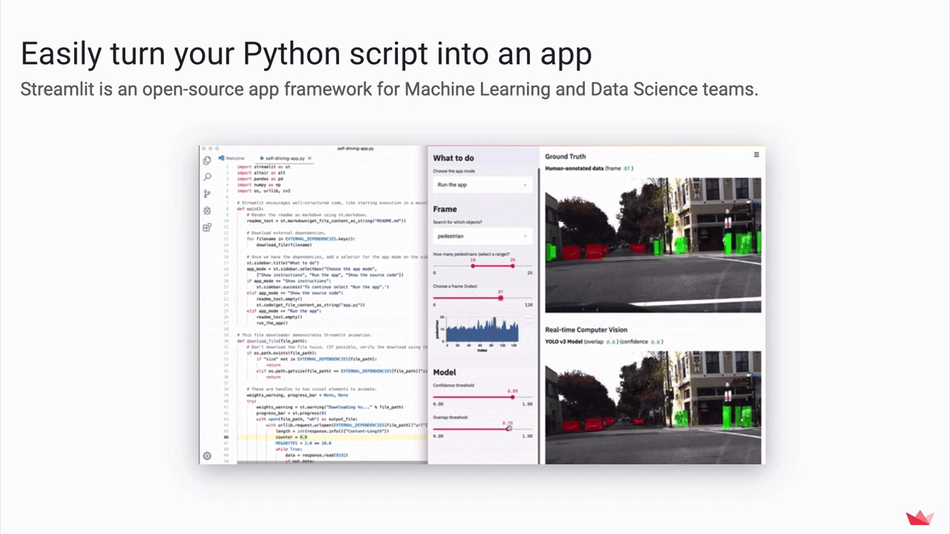

Slide 9
How to Streamlit
Hands-on

Slide 10
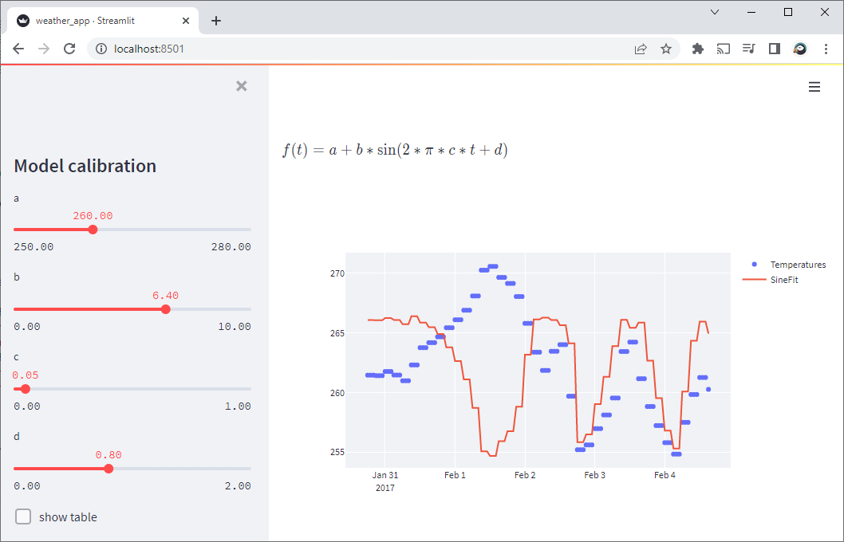
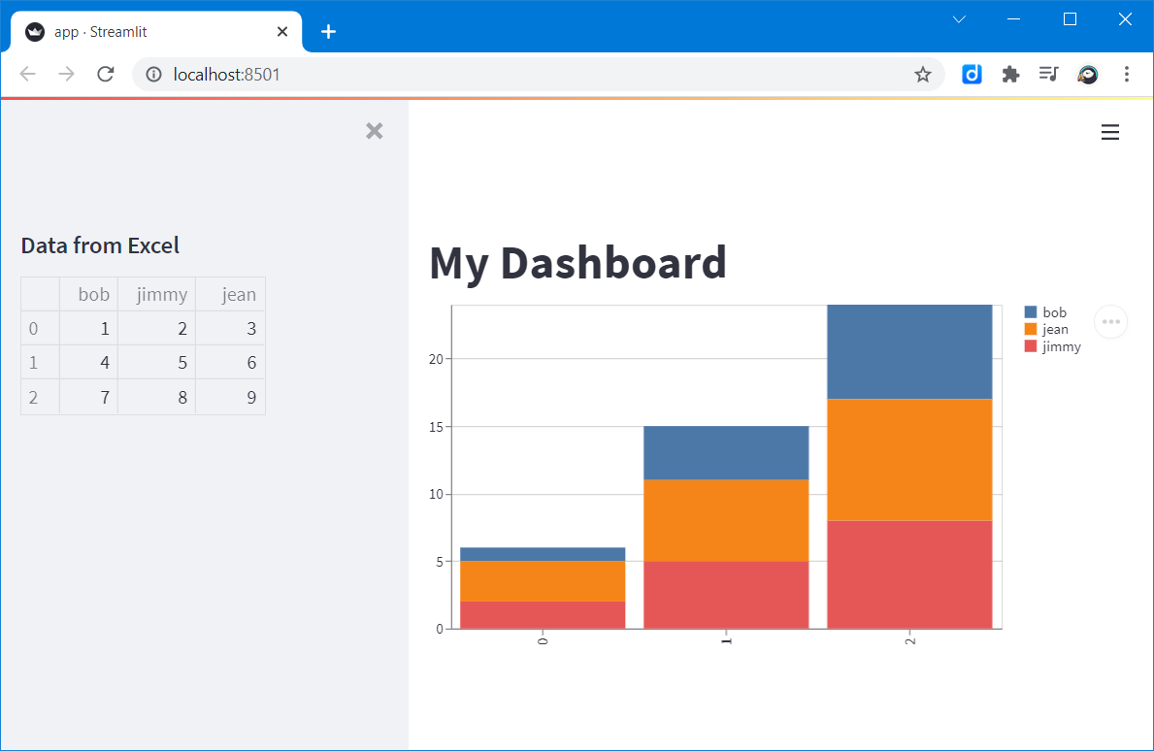
Outcome
At the end of this training, you should be able to deploy the following Streamlit web app.

Slide 11
Streamlit web app
Develop your first hello_app.py:
Test locally: $ streamlit run hello_app.py
/!\ Install with pip: $ pip install streamlit
import streamlit as st
st.write("Hello World!")
You can now view your Streamlit app in your browser.
Local URL: http://localhost:8501
Network URL: http://172.16.43.207:8501
Notes:
import streamlit as st
import pandas as pd
param = [260.0,6.4,0.05,0.8]
st.sidebar.title("Model calibration")
st.write("$f(t) = a + b * \sin(2*\pi*c*t + d)$")
a = st.sidebar.slider("a",250.0,280.0,param[0],1.0)
b = st.sidebar.slider("b",0.0,10.0,param[1],0.1)
c = st.sidebar.slider("c",0.0,1.0,param[2],0.01)
d = st.sidebar.slider("d",0.0,2.0,param[3],0.1)
SineP =[a,b,c,d]
df = pd.read_csv('temp.txt')
from math import sin,pi
# SineP(1)+SineP(2)*sin(2*pi*SineP(3)*tt+SineP(4)));
def Sine(t):
return SineP[0]+SineP[1]*sin(2*pi*SineP[2]*t+SineP[3])
t = df.temp
SineFit = [ Sine(x) for x in t ]
import plotly.graph_objects as go
fig = go.Figure()
fig.add_trace(go.Scatter(x=df.time, y=df.temp,
mode='markers',
name='Temperatures'))
fig.add_trace(go.Scatter(x=df.time, y=SineFit,
mode='lines',
name='SineFit'))
st.write(fig)
t = st.sidebar.checkbox("show table")
if t:
st.write(df)

Slide 12
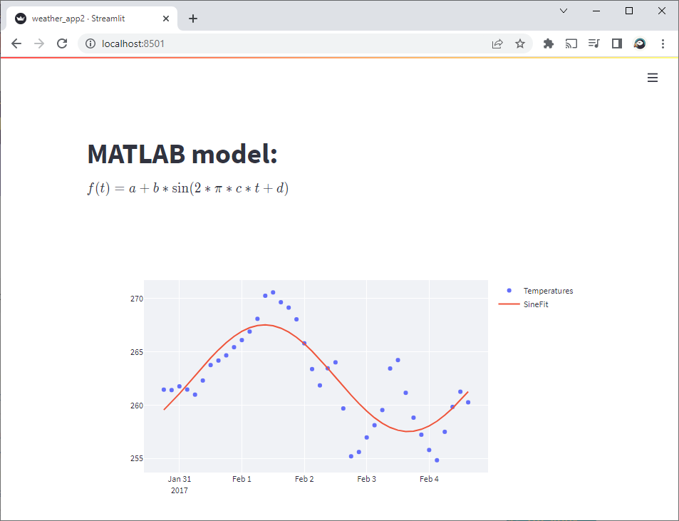
Weather model
Notes:
import streamlit as st
import urllib.request
import json
import matlab
import sineFit
# from samples import get_forecast_url
def get_forecast_url():
url = "https://samples.openweathermap.org"
response = urllib.request.urlopen(url)
html = response.read()
json_data = json.loads(html)
return json_data['products']['forecast_5days']['samples'][0]
# get forecast
url = get_forecast_url()
response = urllib.request.urlopen(url)
html = response.read()
json_data = json.loads(html)
temp = [l['main']['temp'] for l in json_data['list']]
# get time
from datetime import datetime
time = [datetime.utcfromtimestamp(l['dt']) for l in json_data['list']]
# app title
st.title("MATLAB model:")
st.write("$f(t) = a + b * \sin(2*\pi*c*t + d)$")
# call MATLAB model
t = list(range(1,41))
mat_t = matlab.double(t)
mat_temp = matlab.double(temp)
mysine = sineFit.initialize()
SineVal = mysine.sineFit2(mat_temp)
SineV = list(SineVal[0])
# plot data + model
import plotly.graph_objects as go
fig = go.Figure()
fig.add_trace(go.Scatter(x=time, y=temp,
mode='markers',
name='Temperatures'))
fig.add_trace(go.Scatter(x=time, y=SineV,
mode='lines',
name='SineFit'))
st.plotly_chart(fig)

Slide 13



Before Streamlit Other web frameworks
Flask
Django
https://realpython.com/django-setup/
https://realpython.com/python-web-applications/
https://realpython.com/get-started-with-django-1/

